Slide 1
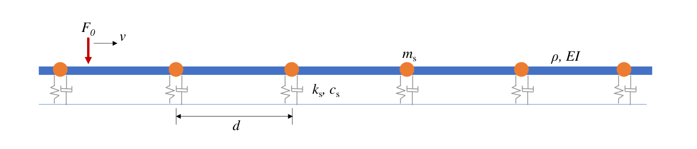
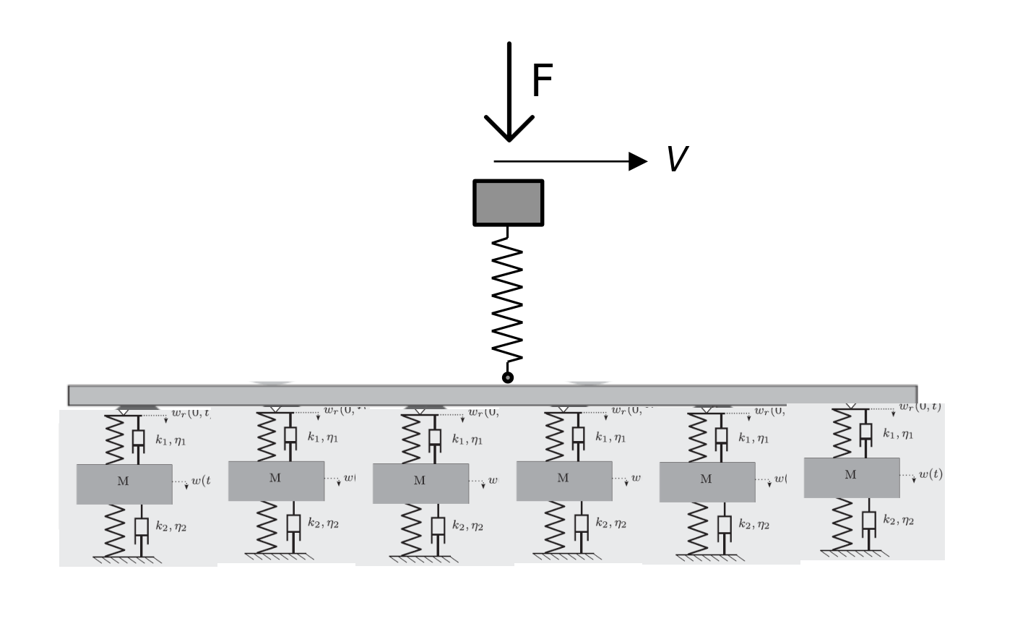
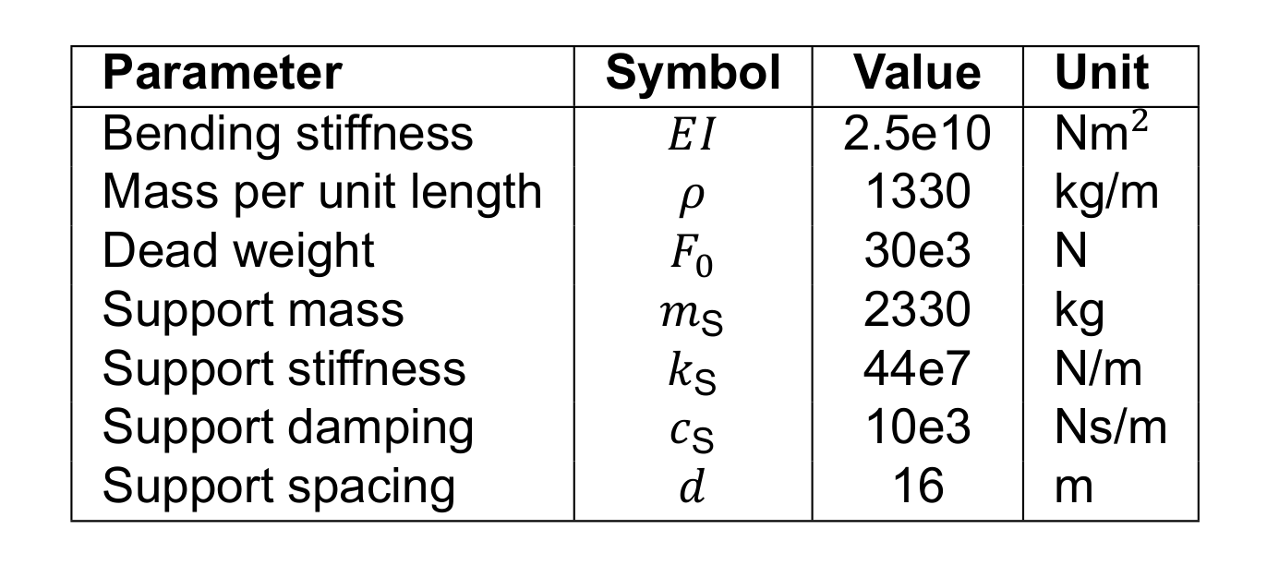
U3 - ML - B
STRUCTURAL SCHEME

Slide 2
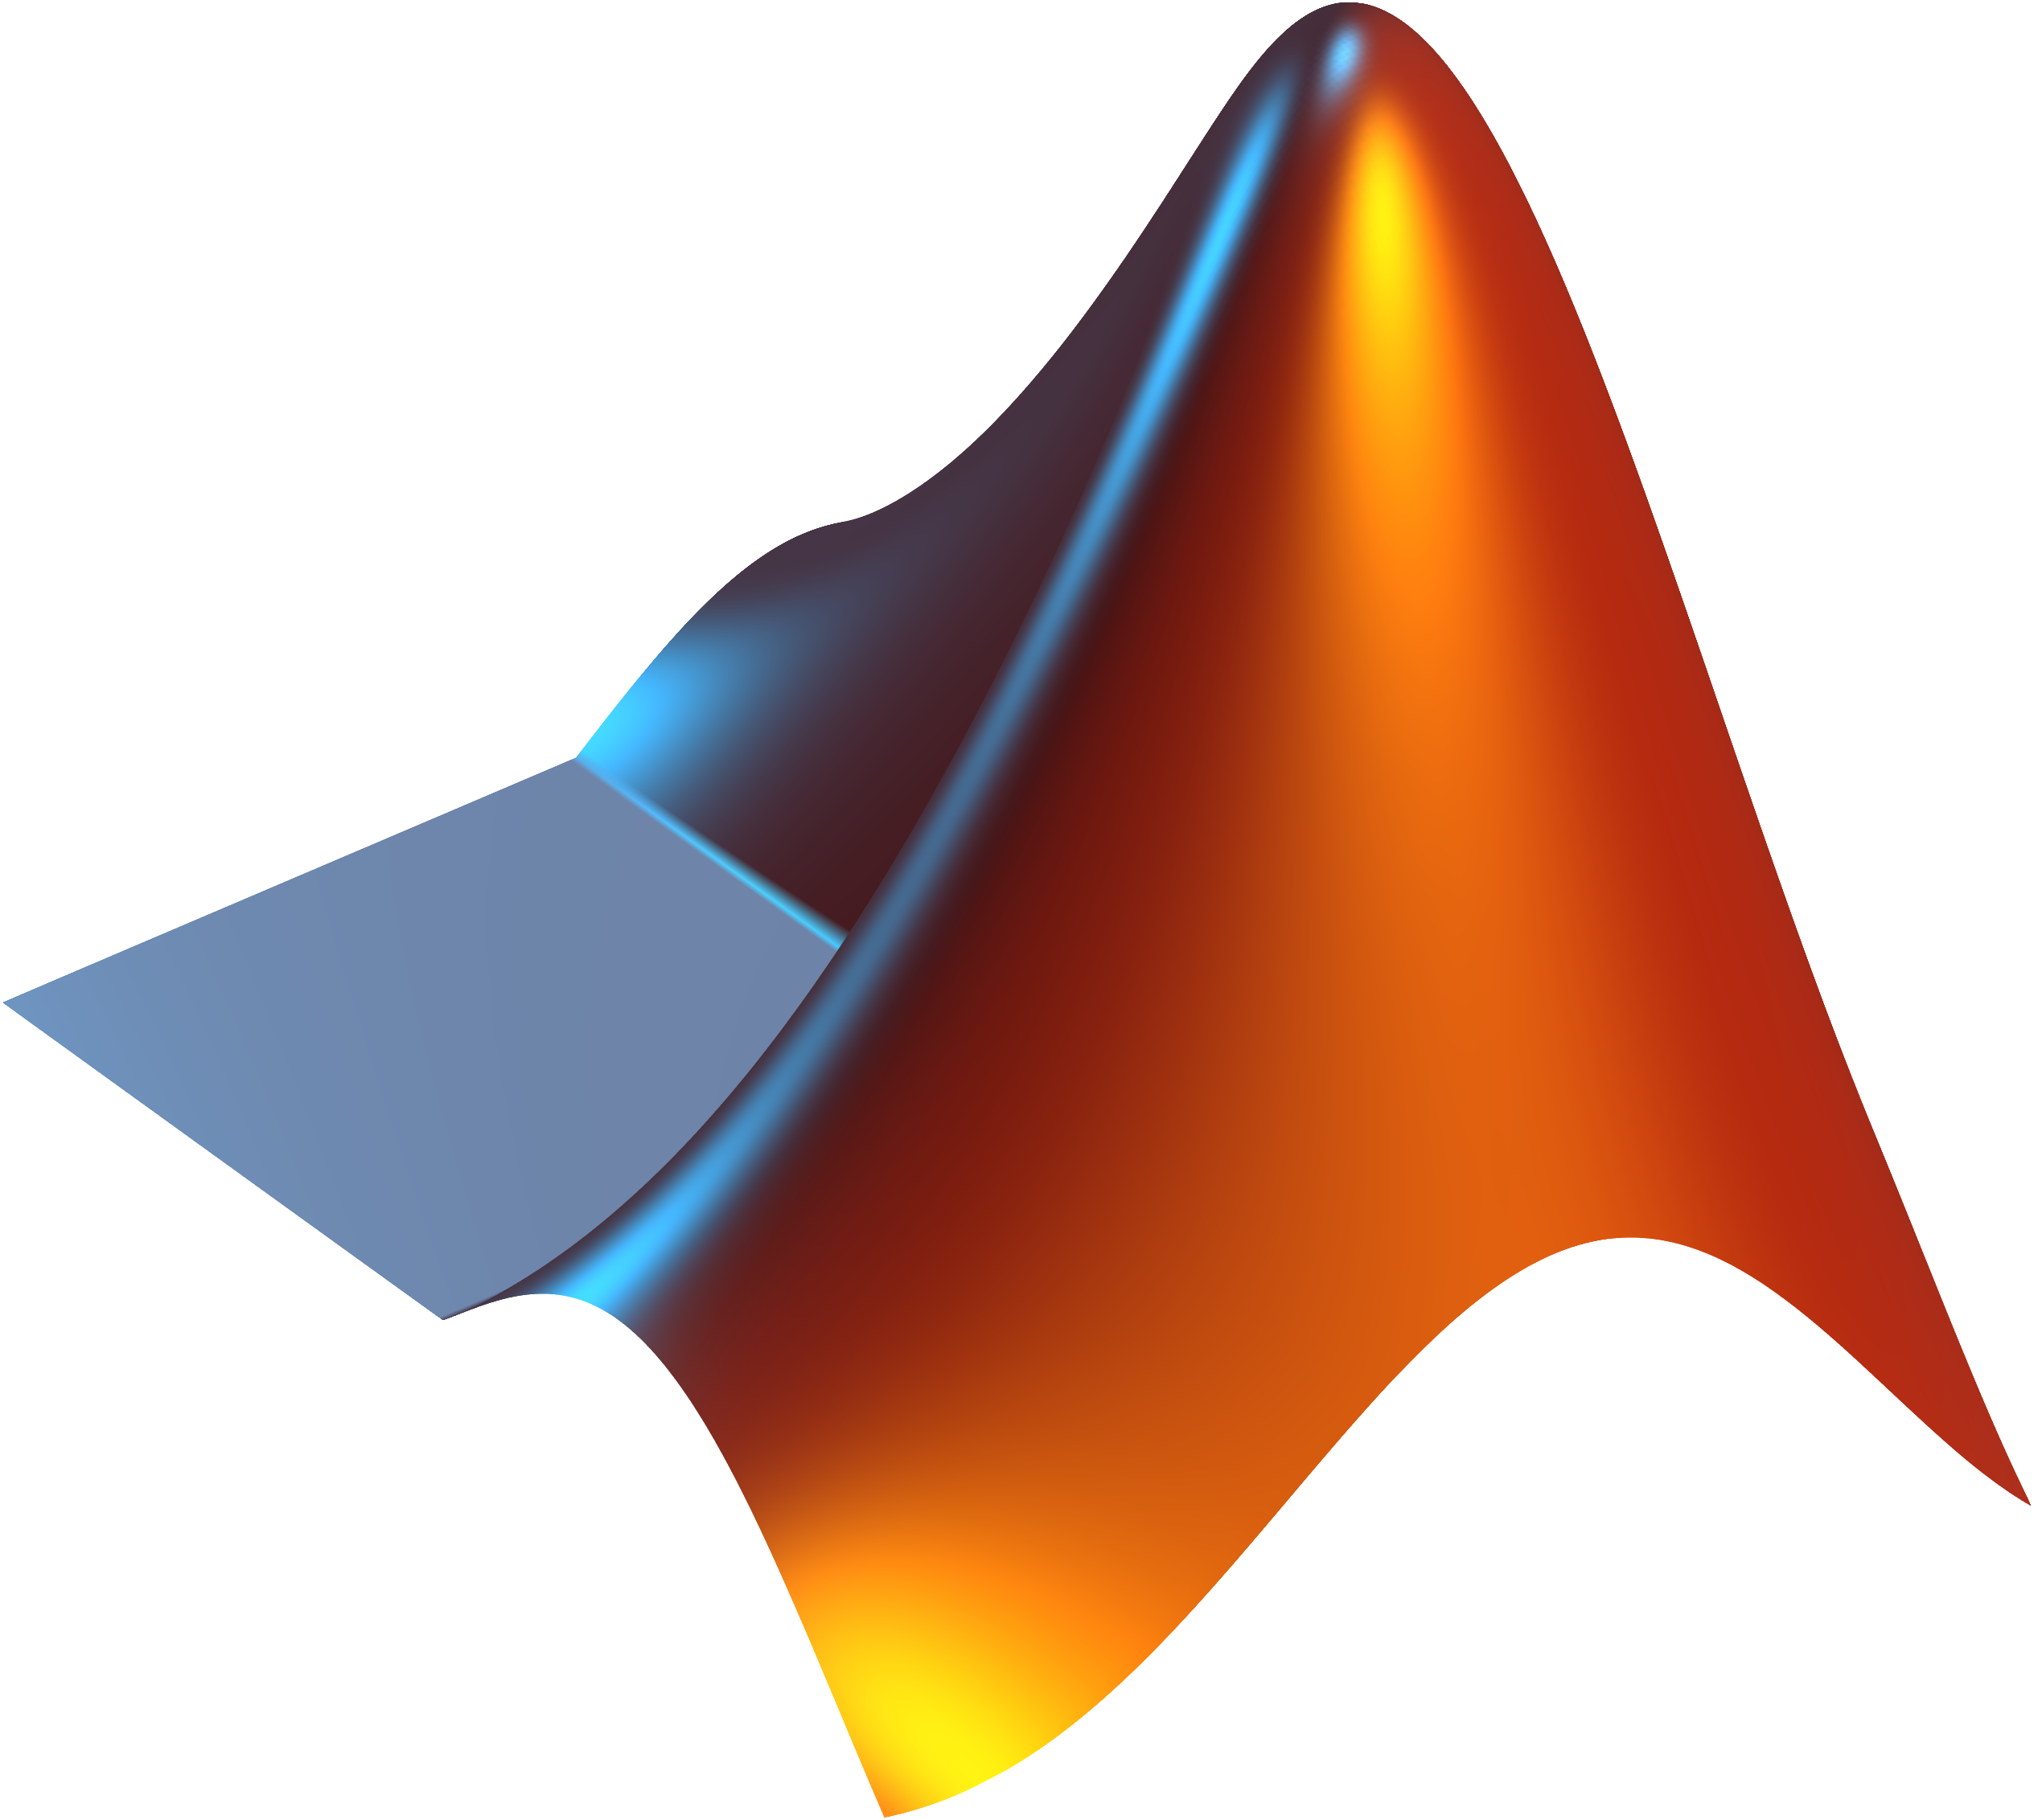

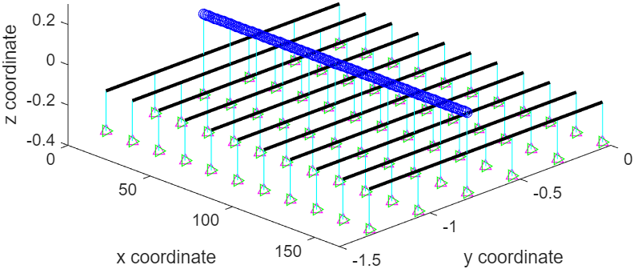
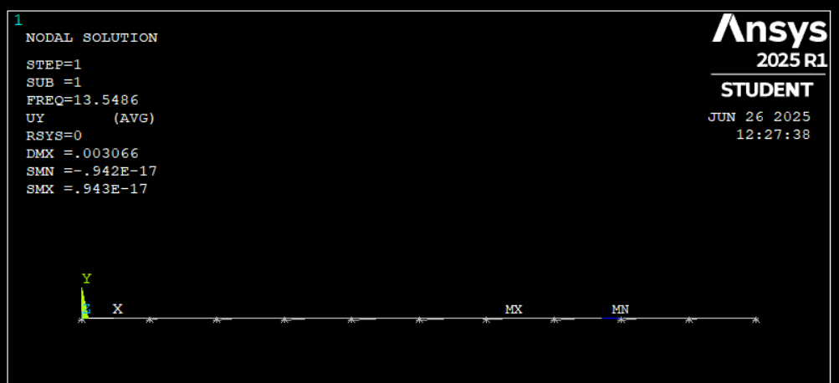
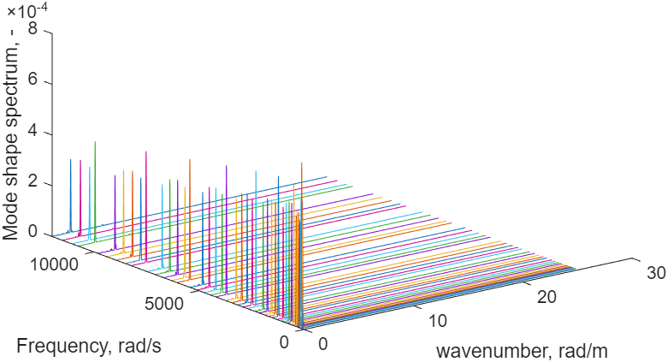
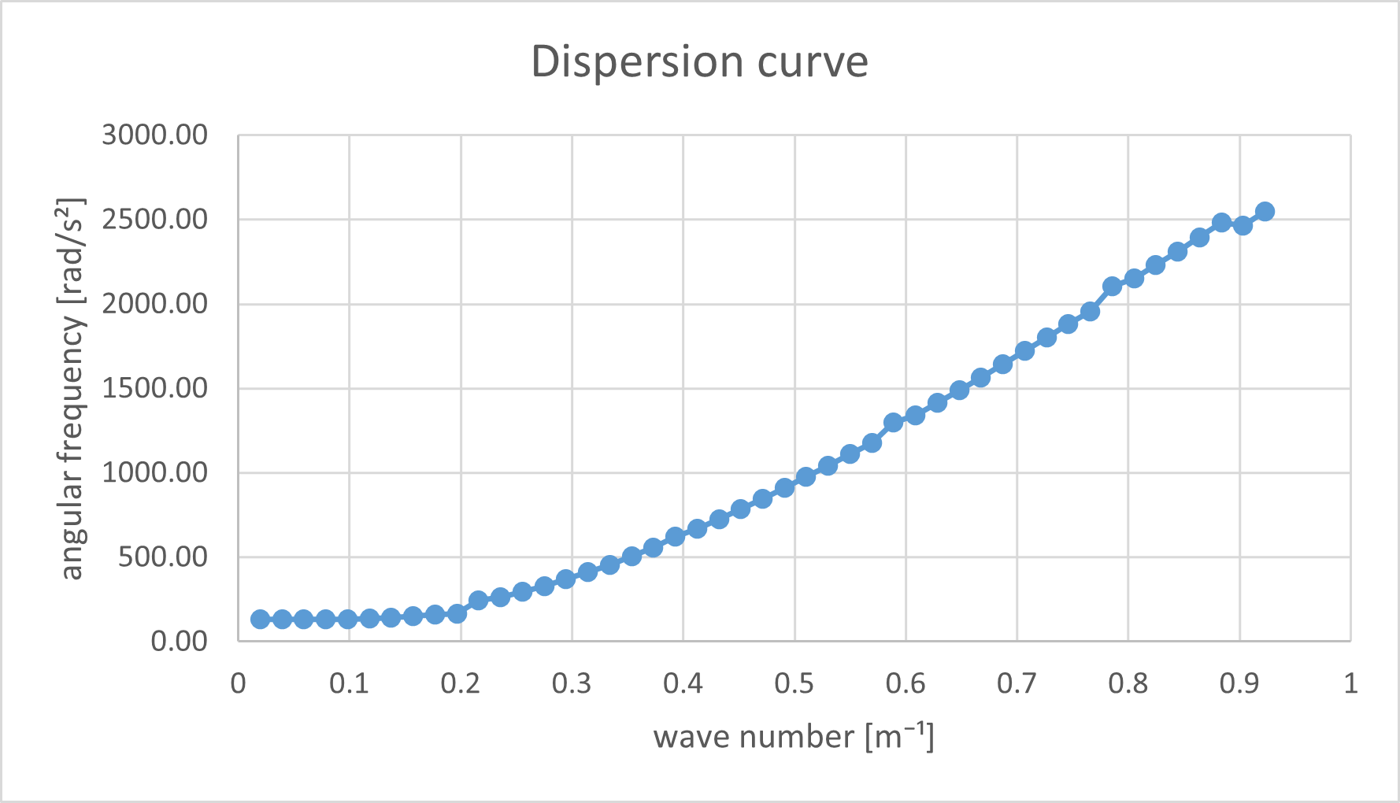
U3 ML B
MATLAB
ANSYS

Slide 3
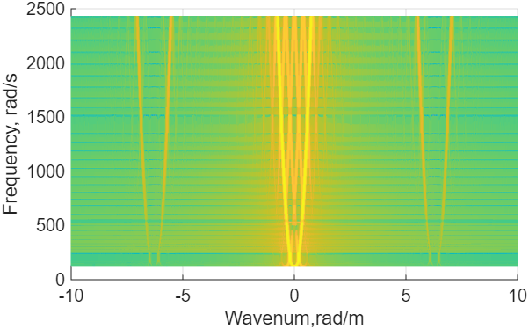
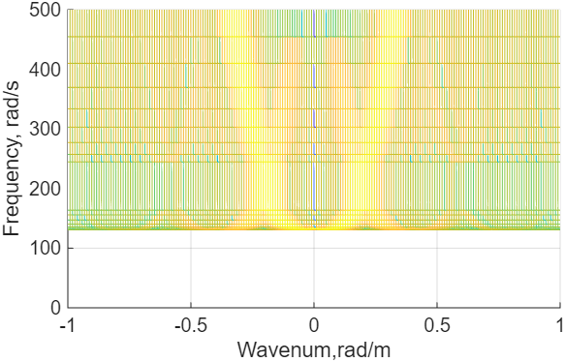
U3 ML B
MODEL COMPARISON
DISPERSION CURVE FROM MATLAB

Slide 4
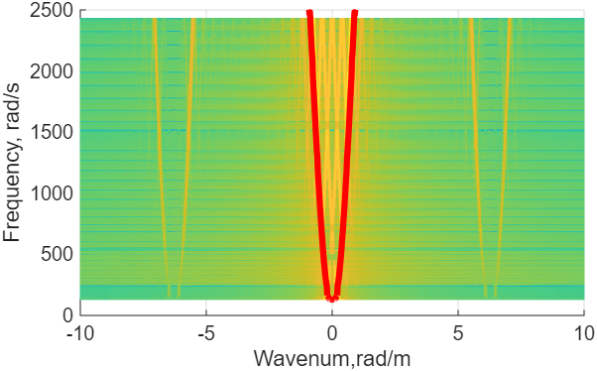
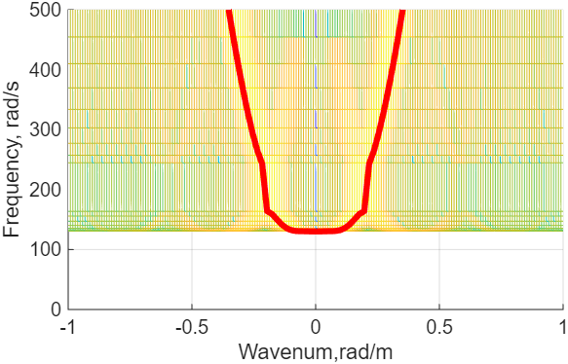
U3 ML B
MODEL COMPARISON
DISPERSION CURVE WITH ANSYS RESULTS OVERLAY

Slide 5
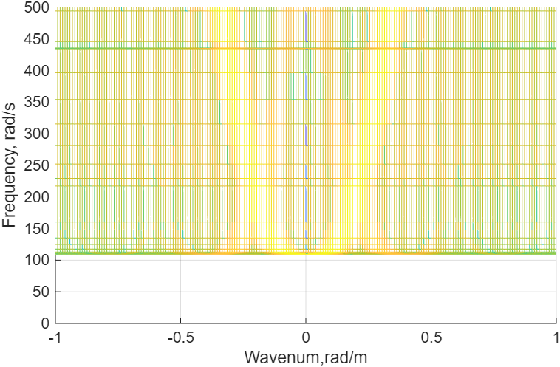
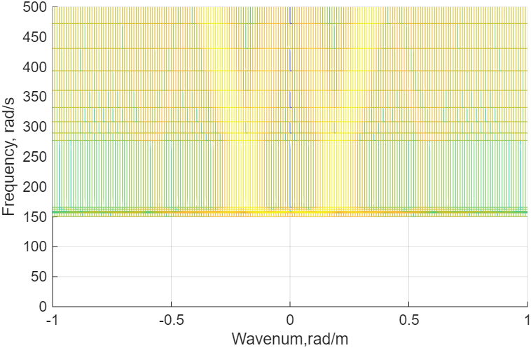
U3 ML B
SENSIVITY TO STIFFNESS VARIATION
REDUCED SUPPORT STIFFNESS
INCREASED SUPPORT STIFFNESS

